Slide 1
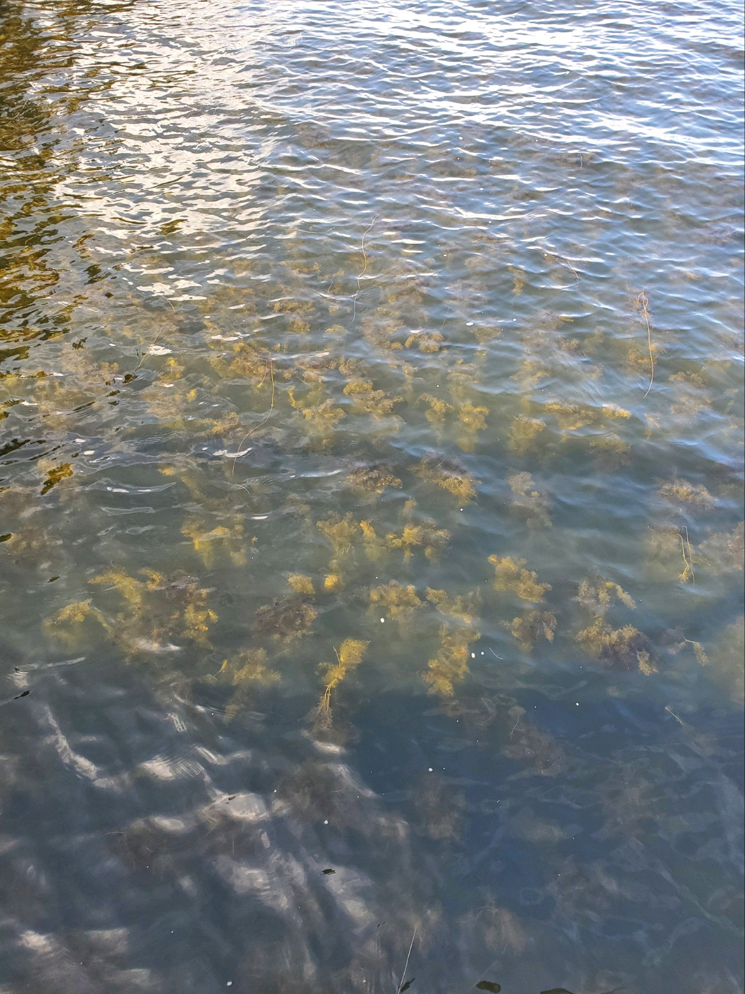
Cape Meares Lake
Eurasian Watermilfoil Treatment

Slide 2
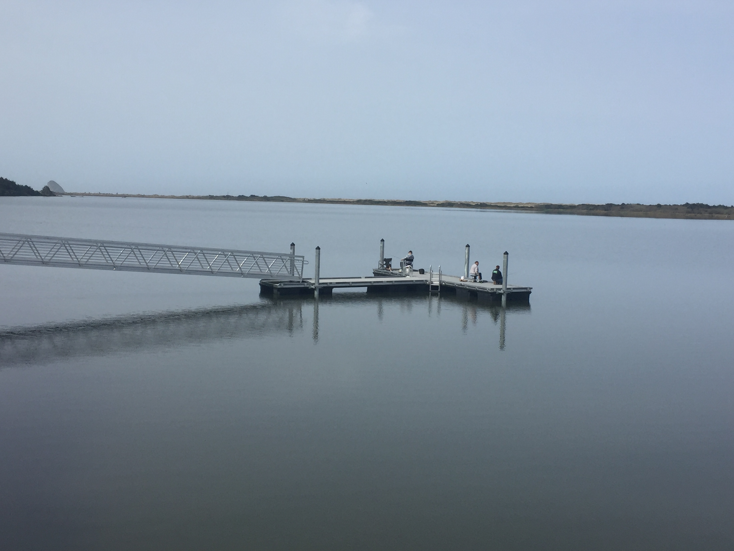
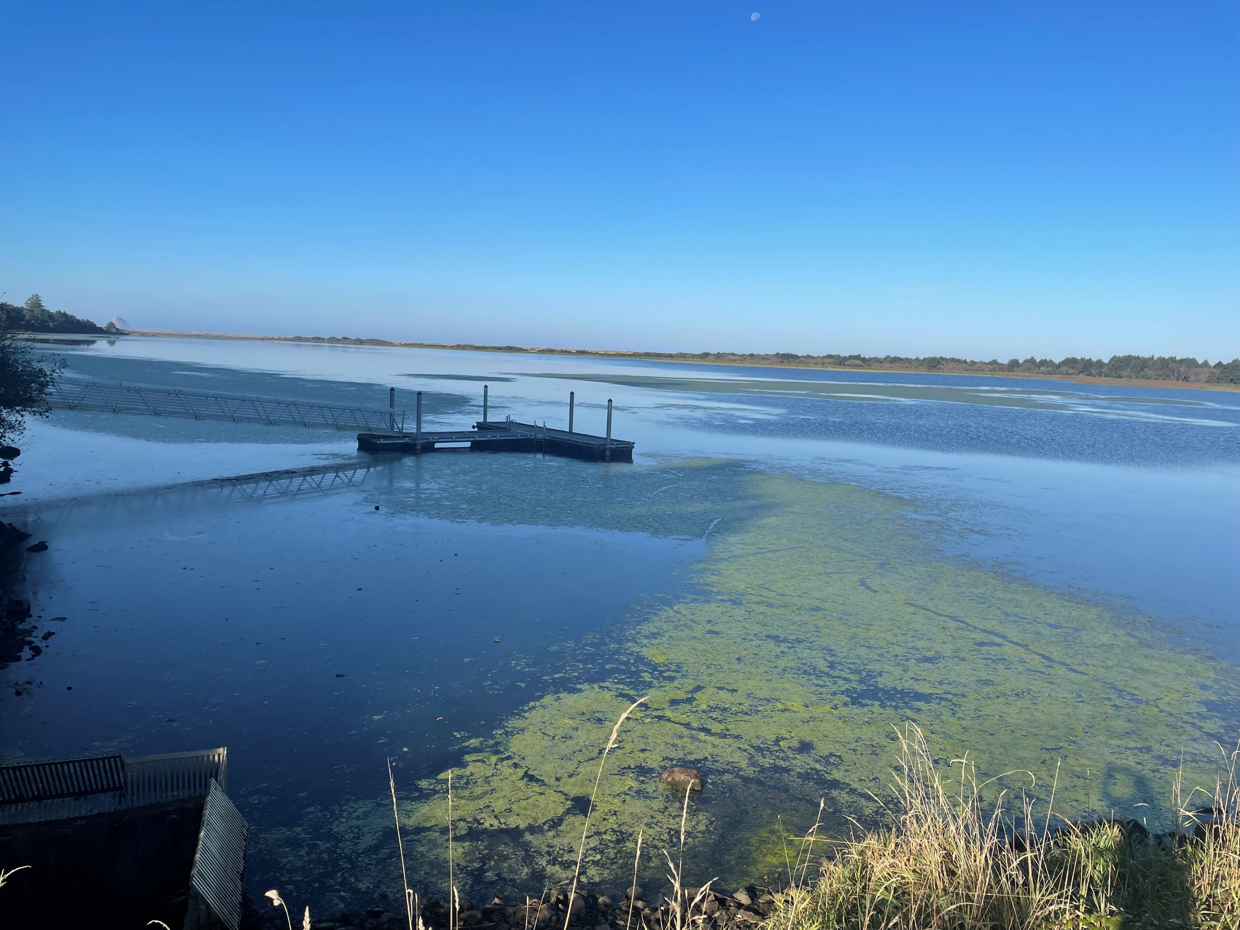
Eurasian Watermilfoil was introduced to Cape Meares Lake and has spread rapidly over the past 3-4 years.
2018
2022

Slide 3
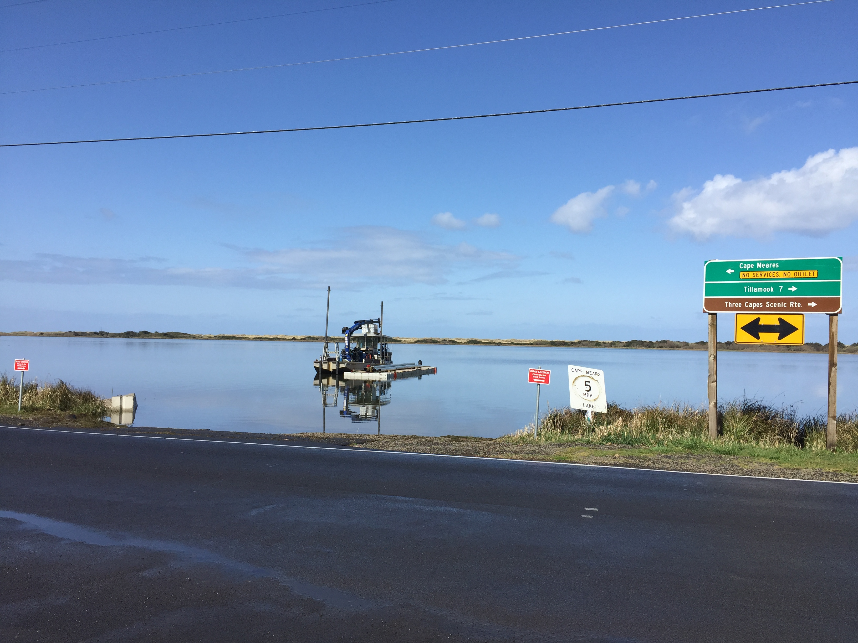
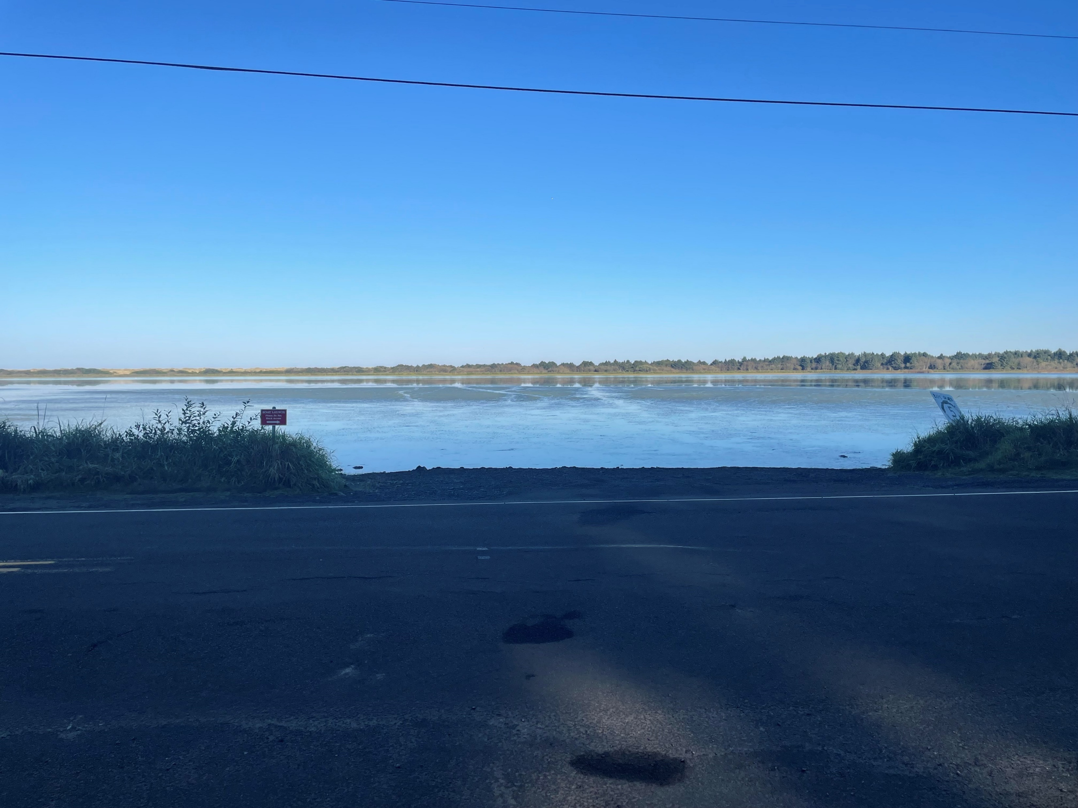
2018 vs. 2022

Slide 4
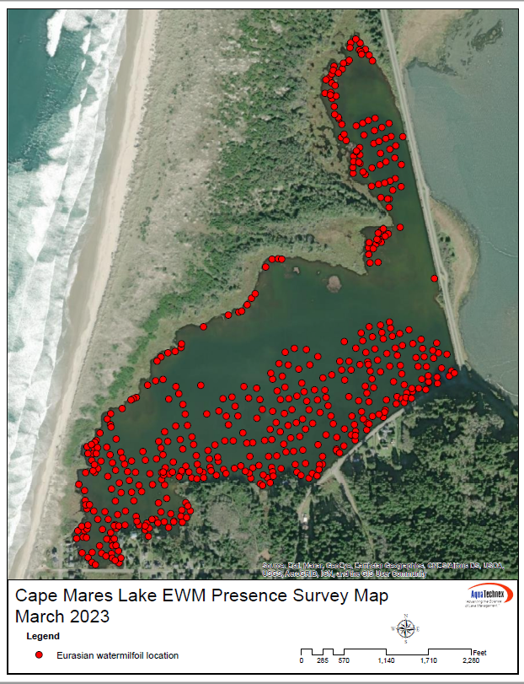
Lake survey spring 2023
Lake Bathometry
Volume for treatment
Active Eurasian Watermilfoil growth

Slide 5
Reasons For Treatment
Improve angler access and opportunity.
  ODFW stocks 13,000 rainbow trout annually.
  Warm water fisheries for Largemouth bass and panfish.
Improve boater access and safety.
  OSMB boater survey 2017
  800 days of boating
  50% split between motorized and nonmotorized boats
  Angling, flatwater paddling, waterfowl hunting
Improve lake health and protect native plant species.
Improved maintenance

Slide 6
Treatment Challenges and Plan
Eurasian Watermilfoil spreads by fragmentation, making mechanical removal impossible.
Grass Carp are neither legal nor feasible for use in Cape Meares Lake.
Aquatic herbicide is the only effective option
ProcellaCOR_EC is a specialized family-specific aquatic herbicide that targets Eurasian Watermilfoil and will not affect native aquatic plants.
Has a DEQ reduced risk designation.
Will not kill native plants, fish, and no isolation/quarantine period is required.
Application will be conducted by certified, product qualified, applicator. – Aquatechnex LLC
Two treatments of the lake are planned for July 2023

Slide 7
Why Aquatechnex LLC?
Proven Track Record and a wealth of experience
  Successful treatments of American Lake and Vancouver Lake in Washington
Specialized equipment
  High pressure submerged applicator that increases uptake by plants and eliminates overspray
  Air boats for shallow/weedy areas
Only certified ProcellaCOR applicator West of the Rockies
  SeaPRO, the company that makes ProcellaCOR only sells to product certified applicators

Slide 8
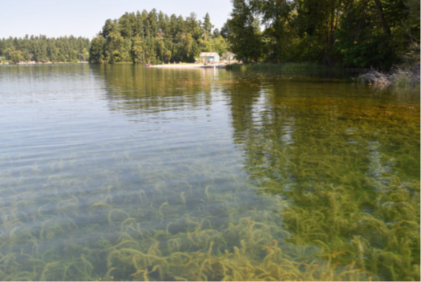
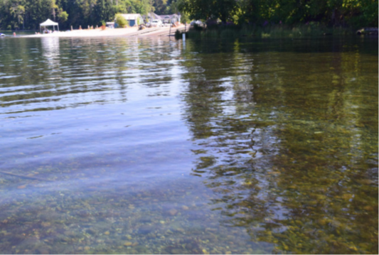
American Lake Case Study – Lakewood, WA
Pre Treatment
One Year Post Treatment

Slide 9
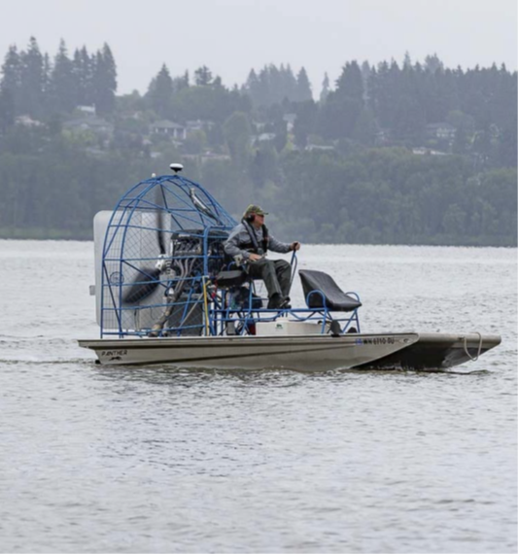
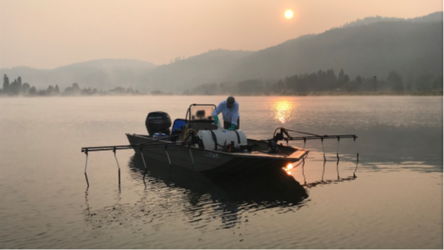
Specialized Equipment

Slide 10
Post Treatment Goals and Plans
Eradication of Eurasian Watermilfoil; may require follow up.
ODFW will conduct post treatment monitoring
Spot treatment may be necessary
Outreach and education to reduce the risk of reintroduction

Slide 11
Questions?

