Slide 1

Healthcare Advocacy
for
Self and Others
Presented by:
Margo Lalich, MPH, BA RN, Co-Founder North Coast EOL Collective
Date: 9/20/2025

Slide 2


“.....we know conversations, connection, and learning about death and dying can improve the quality of one’s life and create a sense of community around a profound experience we all share.”

Slide 3
What does Living Well and Ending Well mean to you?

Slide 4
Objectives
Understand the role of self-advocacy in healthcare
Define what it means and why it is essential at every stage of care.
Recognize challenges and barriers
Identify personal and system-level factors that can limit self-advocacy.
Learn strategies and tools to strengthen advocacy
Explore practical approaches for individuals, caregivers, and healthcare teams.
Apply learning through scenarios and reflection
Connect concepts to real-life examples and plan for situations when others may need to advocate on your behalf.
.

Slide 5
Why Self Advocacy Matters

Slide 6
Self-advocacy is the ability to speak up for your needs, make informed decisions, and ensure your voice is central in your care.

Slide 7
Stages of Self Advocacy
Laying the foundation: Staying Proactive Before Illness
Navigating Care When Health Concerns Arise
Advocating for Yourself and Others with Advancing Age

Slide 8
Sharing Past Health Care Experiences
What happened?
How did you feel (especially about not being heard)?
What do you wish had been different?
Can you describe a time when you didn’t feel your concerns were listened to?
How did that affect the outcome of your care or your trust in the provider?
What would you have wanted to hear or experience instead?
How have you advocated for yourself or a loved one in healthcare?
What challenges did you face, and how did you address them?

Slide 9
Psychosocial Barriers to Self Advocacy
Personal Perspective:
Fear of speaking up or challenging authority
Lack of health literacy or confidence
Cultural beliefs and stigma around illness or death
Emotional distress, anxiety, or depression
Limited support from family or community
Ageism
Healthcare Perspective:
Time-limited appointments and rushed communication
Power imbalances between providers and patients
Complex insurance and billing systems
Bias, discrimination, or inequities in care
Lack of integration between medical, social, and community supports
Access to care

Slide 10
Elements of Courageous Conversations in Health Care and End of life Planning

Slide 11
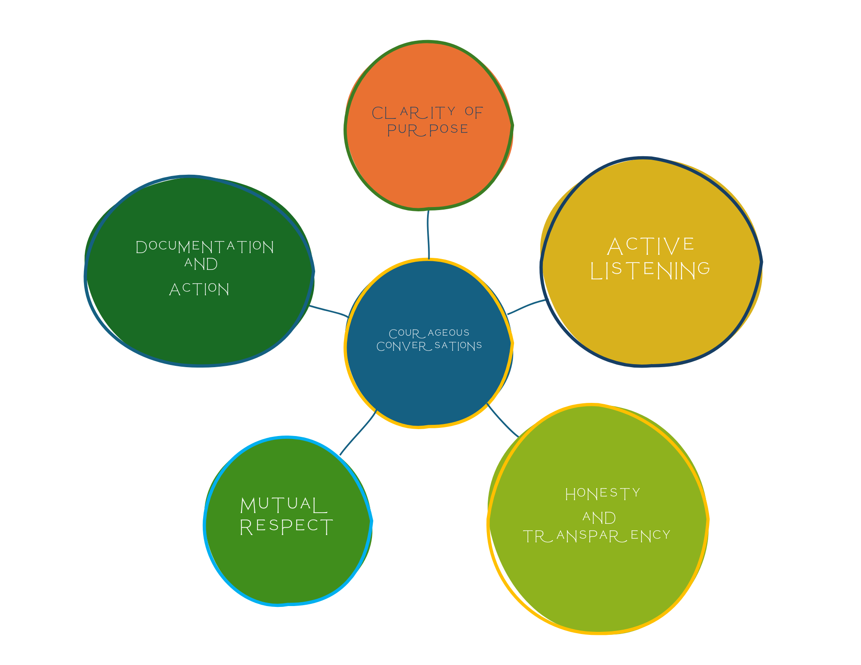

Slide 12
        Willingness to Begin
                Acknowledge discomfort and choose to start the conversation.
Clarity of Purpose
  Focus on values, goals, and priorities—not just medical decisions.
Active Listening
  Listen without interrupting or judgment.
  Reflect back what you hear to ensure understanding.
Honesty and Transparency
    Share hopes, fears, and limitations openly.
    Use “I” statements: “I am afraid of being in pain” or “I want to be at home.”
Mutual Respect
  Honor cultural, spiritual, and personal differences.
  Allow all voices in the conversation to be heard.
Documentation and Action
  Translate conversation into concrete steps: advance directives, healthcare proxy, care preferences.
  Revisit as circumstances change.

Slide 13
Your Voice Shapes Your Care
Self-advocacy enables patients(you) to take control of your healthcare experience. Throughout all stages, from prevention to end-of-life care, it guarantees enables a person’s values, needs, and rights are prioritized in the
decision-making process.

Slide 14
When others advocate on your behalf
Advance care planning documents (Advance Directives, Living Will)
Designated health care proxy or Durable Power of Attorney
Clear communication of your values and wishes shared with loved ones
Written instructions for medical preferences (treatments to accept or decline)
Trusted relationships with care team and family members

Slide 15

“If we talked as honestly and openly about death as we do pregnancy and childbirth, we might live differently.”
THANK YOU!
Get in contact with us
www.northcoasteolcolletive.com
@northcoasteolcollective

